Slide 1
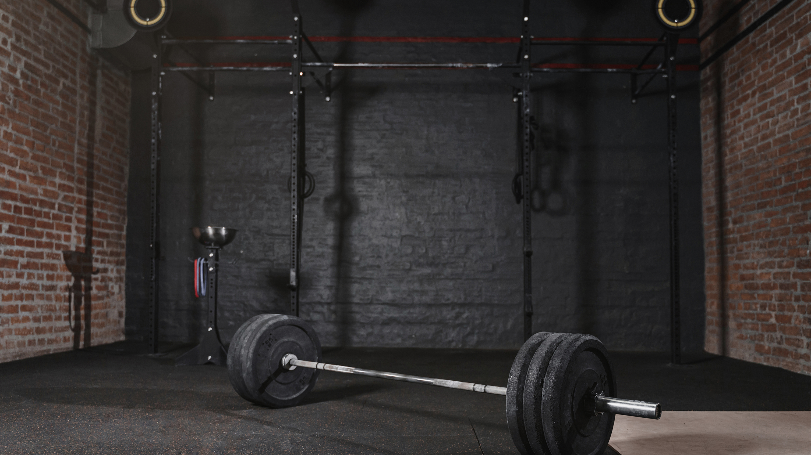
CIRCUIT TRAINING
PHYSICAL EDUCATION

Slide 2
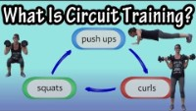

Slide 3
TRUE or FALSE: CAN CIRCUIT TRAINING IMPROVE MUSCULAR STRENGTH, MUSCULAR ENDURANCE AND YOUR CARDIOVASCULAR ENDURANCE SIMULTANEOUSLY?

Slide 4
WHAT ARE EXAMPLES OF CIRCUIT TRAINING EXERCISES?

Slide 5
TODAY’S CIRCUIT TRAINING WILL INCLUDE THREE ROUNDS LASTING 30 SECOND CONTAINING 5 EXERCISES.
YOU WILL ROTATE FROM STATION TO STATION BY WITH YOUR RESPECTIVE GROUP.

